Slide 1
What Is a Relational Database?
A Relational Database is a collection of information that organizes data in predefined relationships where data is stored in one or more tables (or "relations") of columns and rows, making it easy to see and understand how different data structures relate to each other.

Slide 2
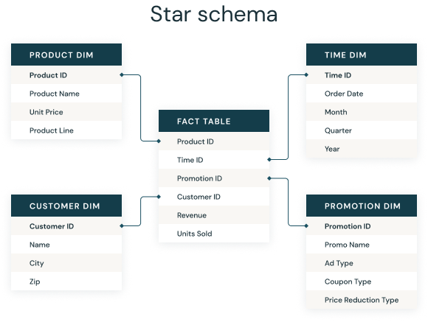
What Is a Relational Database?
Star Schema

Slide 3
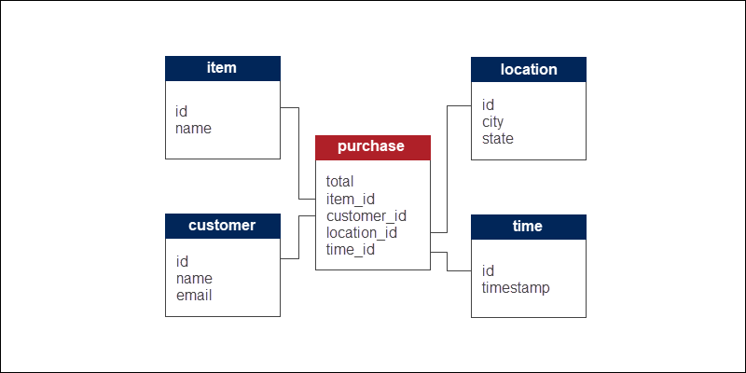
What Is a Relational Database?
Star Schema

Slide 4
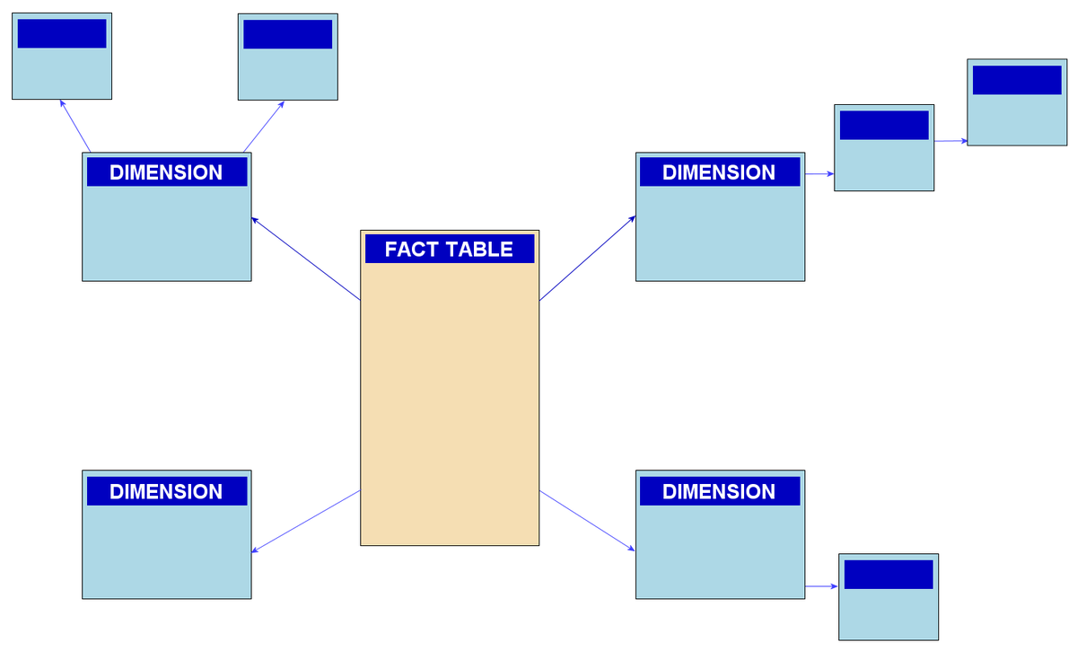
Snowflake Schema

Slide 5
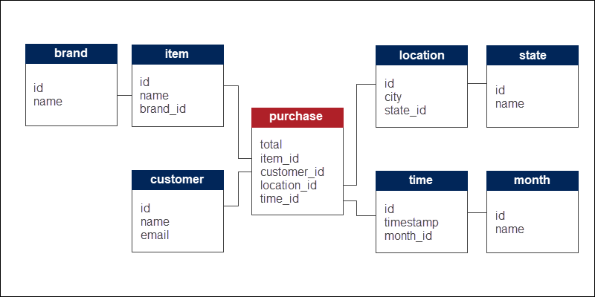
Snowflake Schema

Slide 6
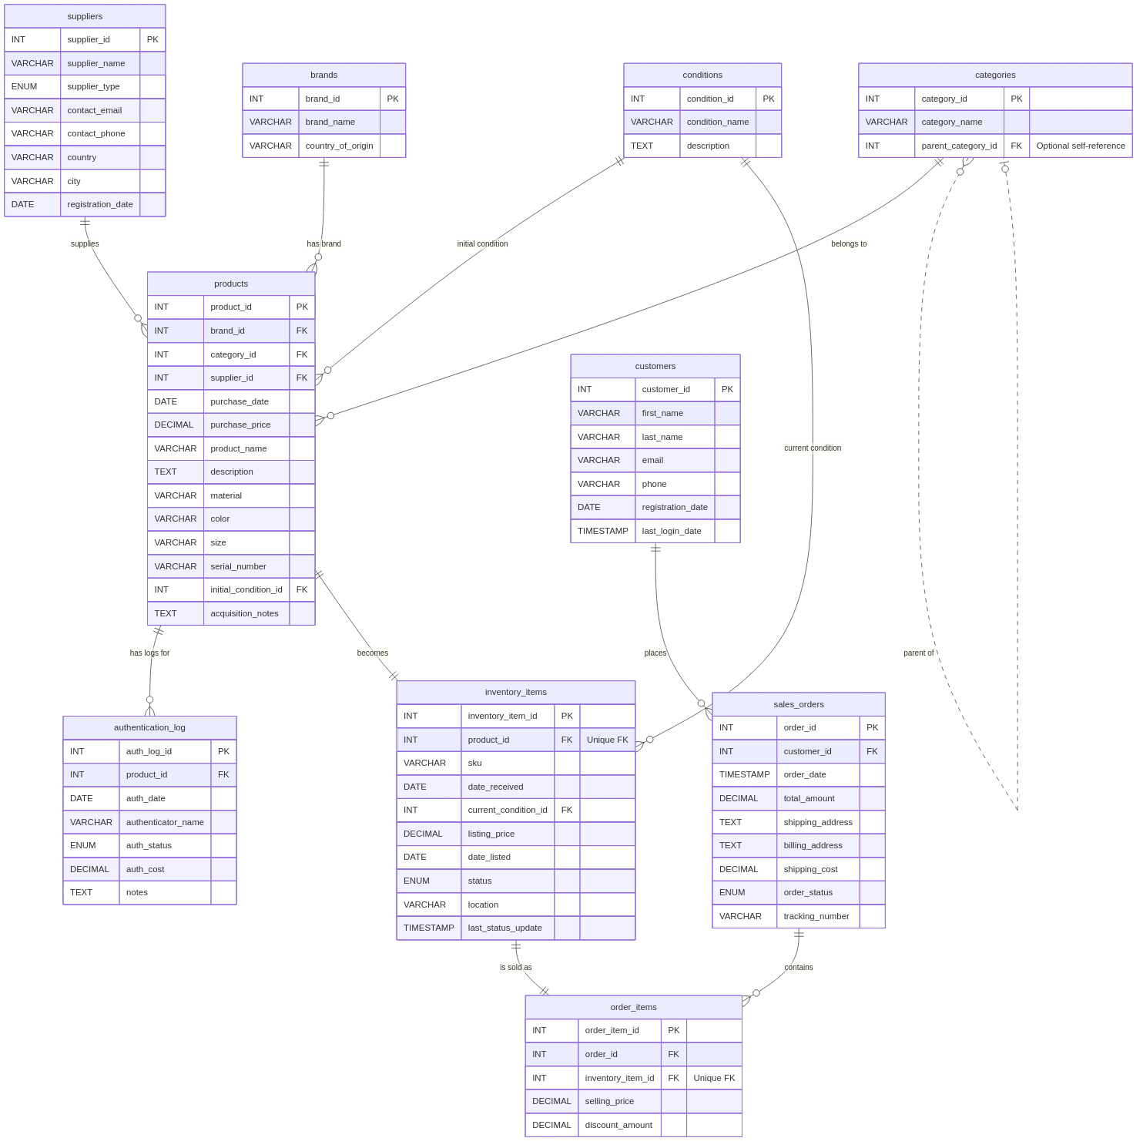
Snowflake Schema

Slide 7
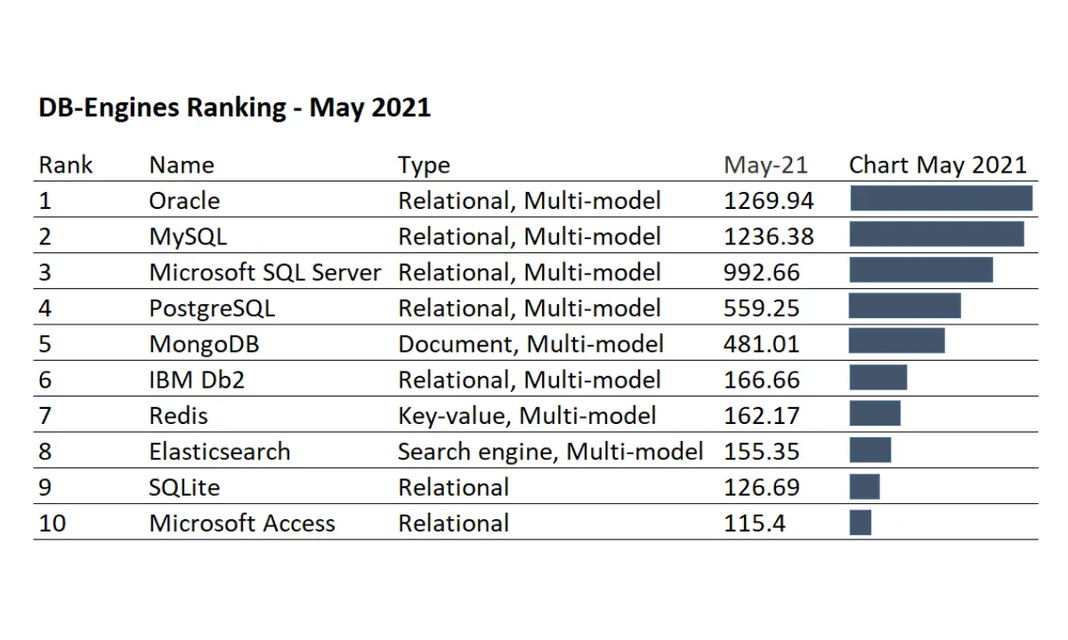

Most Popular Databases

Slide 8
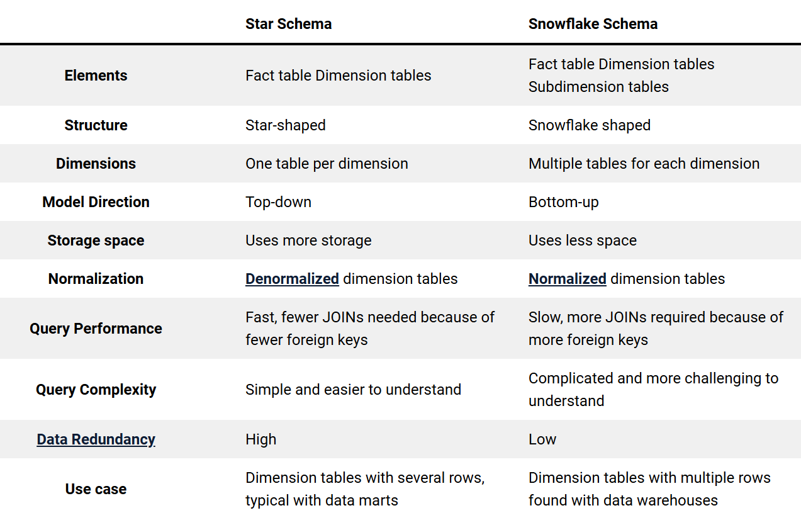
Star vs. Snowflake Schema

Slide 9
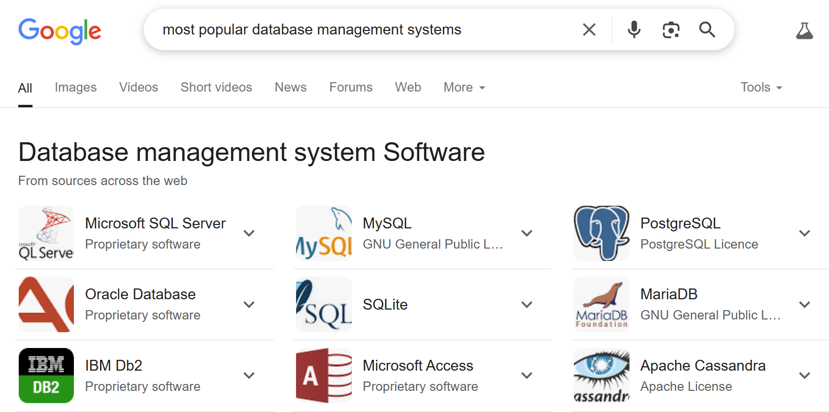
Most Popular Databases

Slide 10
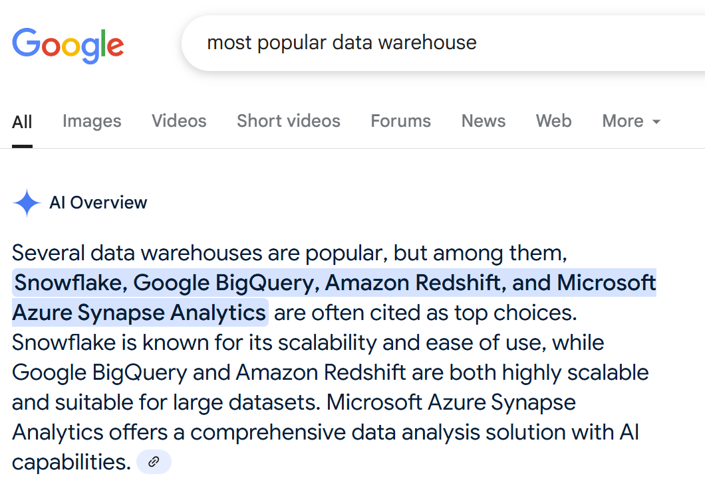
Most Popular Data Warehouses

Slide 11
What is a Serverless Database?
A serverless database is a type of database hosted on the cloud that is fully managed by the cloud service provider. You don't need to manage the underlying servers, infrastructure, or scaling, as the cloud provider handles all of that for you. This means you can focus on your application logic and data, rather than managing the database infrastructure.

